Slide 1

Hello Amma!!!
(to my angry bird rodareshwari)

Slide 2

Love U Amma!!!

Slide 3
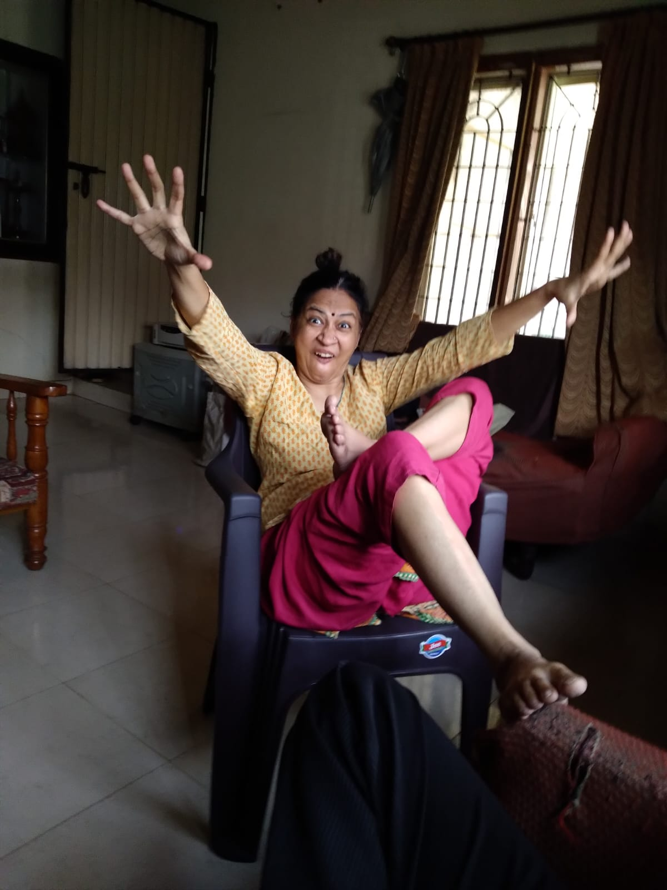

Slide 4

With lots of love

